Slide 1

Knock. Knock. Who’s there?
A message from the future
Notes:
Sometimes there are days I wish I could turn back time and undo some things to pretend they never happened. Almost like git rebase for time.
1927 a British astronomer called Arthur Eddington came up with a concept called “arrow of time”. The concept he posited described the time as unidirectional or asymmetric or always flowing in one obvious direction. But we don’t have to be fancy astronomers to grasp the concept of time
We all understand quite early in our life’s that time is constantly flowing in one direction and there is no turning back. Except when we implement time based business requirements we have a tendency to look back in time and believe that’s the only way to go.
Today I will take you through a journey of time and explore how traditional approaches sometimes fail, what alternatives we can leverage and how we can use durable timeouts to predict the future.
But first I have some shocking news for you

Slide 2
Business logic tends
to be complicated
Notes:
(click)
Thanks Captain obvious for this piece of advise
(click)
Jokes aside when working with clients I see people end up making the same kinds of mistakes repeatedly or more accurately the symptoms are the same.
The way that people make mistakes is very different each time so most of it has to do with business logic, so with regards to business logic.
I think it's fair to say that all of us in our systems have some kind of complicated business logic. But I want to talk about a specific kind.
The kind that involves both commands and queries.
So who is a part of their business logic: sometimes has to look up some additional data?

Slide 3
Hiding
Inconsistencies
Notes:
And it turns out that in that area that when you have your most complicated business logic, which often gives the business. The greatest value. That's where we actually have consistency problems that are hiding.
And this is irrespective of whether you're using Command and Query Responsibility Segregation (CQRS) or not.
Even if you're using a fully synchronous end to end architecture talking to a fully transactional relational database.
These things can bite you
So a lot of times everybody's heard about this eventual consistency.
you can go use it . Mongo web scale and all those kinds of things, but a lot of organizations say, well, we'd rather Keep it safe and stay with the things that we know
I'm here to tell you is that even when you're using this safe architectural choices of doing everything synchronous even when you're using the safe technology choices like using SQL server. Oracle even then, sometimes you could end up with an inconsistent system.
These inconsistency problems get aggravated in multi user collaborative systems

Slide 4
Multi user collaboration
Notes:
The always on perpetually working your lots of users in parallel type of system has become more and more ubiquitous
users expect to be able to access their data. Whenever they want wherever they want and it's not just each user by themselves. When you have a situation where you have users that are only operating on their own data.
Life is actually pretty simple I call those types of systems that are multi single user systems.
They're kind of like a multi user system, but each user's kind of in their own little data and that's it.
It's when users are able to touch each others data that things start to get even more interesting.
Now. Unfortunately, when we look at not just the technologies that we're dealing with, but the programming practices and the paradigms a lot of them are based on that same object oriented thinking Well, you write objects and you persist.
These objects in some kind of database and. It works or at least it works on your machine
pretty well. Then you put it in production in some kind of problems happen.
Usually the way that we address consistency concerns when we have multiple users operating on the same set of data is using things like optimistic concurrency
who's heard of optimistic Concurrency?
So we got our traditional first one wins in last one wins concurrency where first one wins means first user that get in get their changes done last one has to redo their changes.
Sometimes this gets even more interesting when we jump into a user and themselves.
And the users table to do things relatively quickly.
So let's jump right into code.

Slide 5
Frontend
Backend
Database
ASP.NET CORE
Front
Back
Storage
Orders
Read / Write
HTTP
ADO.NET
Notes:
Demo 1
The most traditional innocuous type of domain object that you’ve probably seen the order object everybody when giving some sort of presentation always reverts to retail. So boring as I am I will follow that.
Briefly explain
Switch to code

Slide 6
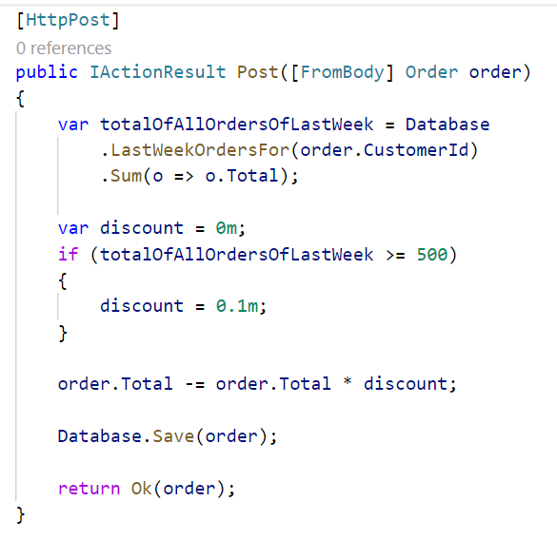
Notes:
Now this order controller is implementing some. I wouldn't call this complicated business logic, but we got a new business requirement that says as
a part of processing a new order. We want to decide under which conditions a customer is going to be getting a discount now.
The customer that is submitting this order in the past week did more than $500 euros Swiss Francs Norwegian kroner Swedish kroner Danish kroner whatever your currency of choice. Then they get a discount. And if not, they don’t.
Your average developer looks at the requirement implements this code doesn't really think twice checks that it works
The area where things become a little bit tricky is what happens if it’s 2 or more users.
But the customer in essence is an account and we can have multiple users from the same account buying stuff on the same account. So we have two or more users at the same time, both of them are submitting an order.
Run demo
Alright so imagine 2 threads going through that logic at the same time, where the last week of orders was $300.
Each of them is submitting a new $300 order.
Both of the logic goes down to the database. Both threads go to the database take a look at all of the existing orders.
Oh. No, we've only got $300 worth of orders

Slide 7
And then the customer walks into your office
Notes:
For one of the order the customer didn’t get a discount. You can imagine this gets worse the more concurrent requests we get from the same customer. Where if these users just made their requests a couple of seconds apart, then one of them would have gotten a discount.

Slide 8
Notes:
Now that's not a very nice thing to do when you think about it, I mean, ultimately, we are penalizing our users.
For this type of behavior for purchasing too quickly.
So in short we can say

Slide 9
Concurrency and latency in collaborative
domains can lead to incorrect application of business rules even in safe architectures
Notes:
How we ended up here to begin with? So this idea about processing these types of things in real time before that, we had the good old solutions. For any kind of data crunching we wrote our good old

Slide 10
Batch Jobs
Batch Jobs
Notes:
Batch jobs
Something that would run nightly back somebody comes along Yanks, a lever and the machine starts humming.
And if it goes to the database and a whole bunch of data crunching stuff. A lot of reading and writing of data.

Slide 11
Frontend
Backend
Database
ASP.NET CORE
Front
Back
Storage
Orders
Read / Write
HTTP
ADO.NET
Scheduler
Notes:
Demo 2
Here's a code that might look like something like that,
Switch to code

Slide 12
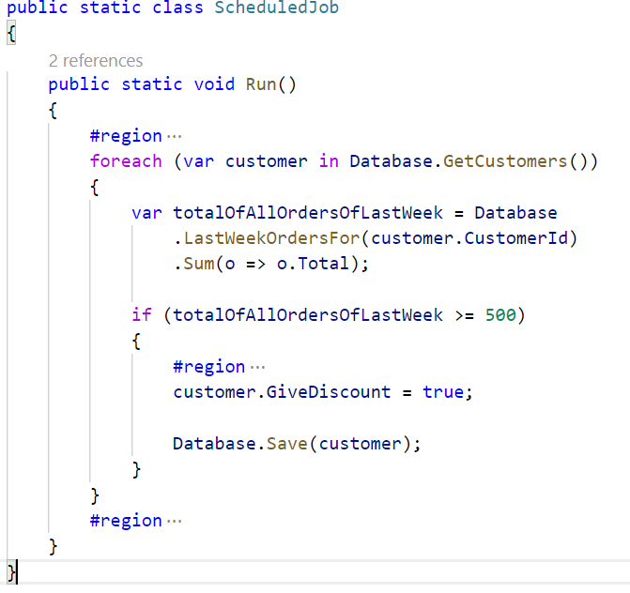
Notes:
so we've got some scheduled job
that's invoked in the nightly batch and what it's doing
is fairly simple just going and looking up.
These types of orders and then saving some sort of flag on the entity.
Doing Alright this customer now should be given a discount.
The problem with that is that we have this sort of reset problem.

Slide 13
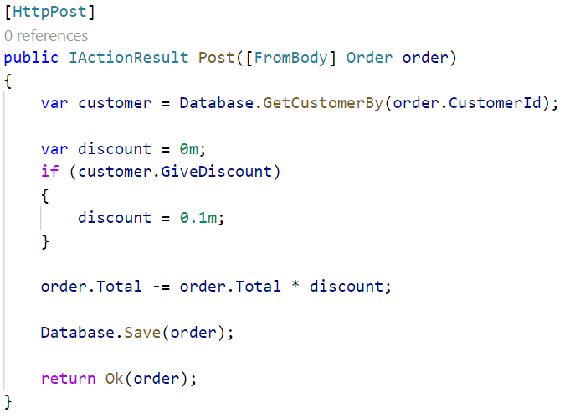
Notes:
And then in terms of the order logic to order logic is simpler. Now we just check that give discounts this is a customer dot give discount.
So this is how we use to approach these types of logic.
You know anytime you need to do a big historical type of data crunching you did, that offline you store. The results in some sort of Boolean values or other rolled up aggregate values and then in the real time environment,
you just check those values.
The problem with this and it was a real business problem is that once again. If we had 2 users coming to us in this case.
It's not clicking the button at the same time in this case, it's actually clicking the button on the same day.
And if we have 2 customers or 2 users from the same account.
Coming to our site, both of them submitting an order.
Then, ultimately, we're saying no sorry if you want to get a discount come back tomorrow. You realize how ridiculous that sound if you are a customer, saying no if you make your purchased today. You don't get a discount.
But if you come back tomorrow. I'll give you a discount.
What’s even worse is that with batch jobs the more successful we are with our business the longer the runtime of the jobs becomes. Our business success is the batch jobs undoing
So it's understandable why businesses all over the world are moving away from these type of batch jobs. It doesn't workout that well and that leads us back
to this type of logic now this shortens downs, the problem.
At least with regards to the discounts.

Slide 14
Batch Jobs increase the window of concurrency problems
Batch Jobs for time based business rules
are the worst enemy for growth
Notes:
The bigger issue is that once again we have a consistency problem. And in order to solve it we need to

Slide 15

Rethink time
Notes:
A lot of our traditional domain models in a parallel
collaborative type of world are defective by design.
Thing is we can do better.
We can do a whole lot better,
but it requires us to think about software and think
about requirements in a slightly different way so.
The hinge in dealing with software in parallel type of
software is exactly that it's that concept of time.
It's rethinking the arrow of time and how we program
with it.
So the traditional requirement that we said was Alright.

Slide 16
t
1 week
Sum(o => o.Total)
Notes:
We've got this stream of orders that are coming into our system. And whenever we get an order we look back in
time, 7 days or whatever the requirement is sum up.
The total value of orders in that period of time and if the value is greater than 500 and some odd dollars.
Then they get a discount and we mentioned the problem was if we have 2 things happening at the same time, we can end up with an inconsistent value.
We can achieve the same result instead of looking backwards in time looking forwards in time.
Which seems a little bit unusual?
How can you predict the future thing is you can’t predict the future but you can?
Fold the future into your programming now and let me explain how you do that logically so when we get an order ultimately what we're interested in is the last 7 day. Total instead of calculating that.
You know at the time of the order.
We can turn that around and say actually let's introduce that concept into our domain itself.
A customer has a 7 day running total of orders because ultimately that's what the business is telling us it’s talking about the last 7 days?

Slide 17
t
WeekTotal
WeekTotal
+= o.Total
1 week
-= o.Total
+= o.Total
1 week
-= o.Total
+= o.Total
1 week
-= o.Total
Notes:
What we're doing is we're just making that explicit so when we get $300 order?
What we're saying is Alright. The 7 day running total is $300 but. That needs to be decrement, in 7 days in the future.
In essence, we want to send data to ourselves 7 days from now saying, You know you need to decrement the 7 day running total 7 days from now.
And as we get this dream of orders that are coming in and we say OK now we increment it by $300 now. And we throw information into the future, and saying decrement it by another $300 then.
And as we keep on going you aggregate the data that we need so that we have a current running total.
That's telling us OK. Now it's $300.
Now it’s $600 etc. And as we catch up to ourselves in time.
Then we need to have that kind of wake up call saying Hey look. It's been 7 days since order number one say, Oh, OK, then what I need to do. Is to decrement it down to 300 OK?
It's been 7 it's been 7 days since order number 2 Alright.
Let's decrement that one down as well.
The difference here is that like I said instead of looking back in time. We look forward in time.
So as we're modeling this as new orders are coming in. We're doing. That same type of behavior over and over and over again, so that when we finally arrive at a specific order.
We're not actually doing a query. We're not doing historical look up. But rather we've folded the history into our current state. But we've done that in a highly consistent way.
The reason that we've done it in a highly consistent way is that what we've done is we've in essence created call it an upside down anti-batch job.
So remember the code that we have with our bad job where we said no over here, we're going to have a customer.
That has some sort of give discount equals true value.
We rolled up some state and we put it in the customer. We're doing the same thing here.
We're rolling up some state and pudding it in the customer. The important thing is that when we're dealing with a
customer or something like that? What we can say is well. Now we have a specific entity that has specific data.
This is one row. In the database. Databases can guarantee us full transactional consistency at the level of a single row.
Others if we have 2 things that are happening at the same time, one of them wants to submit a new order and another one is dealing with a timeout.
Then ultimately that bid is going to lock on that single row.
That, in essence is the trick of an aggregate root to design your logic in such a way that all transactions are touching just a single row a single entity.
However, in terms of programming this requires something that we don't really have.

Slide 18

Program time
Notes:
A way to program time
An you know system threading timer.
Not such a good idea is it.
The problem with those types of in memory timers is
that if our machine crashes.
Well, it won't remember that,
it needs to decrement the value in 7 days.
So we need a highly reliable durable transactional way of
dealing with time,
so that no matter what happens in our system.
We won't lose that information.
Once we have all of this kind of stuff then
will be in a situation where you can say all
right now, we can build real aggregate roots.
One way of achieving that is to leverage our durable scheduler that we might already have in place from the good old days of executing batch jobs

Slide 19
Frontend
Backend
Database
ASP.NET CORE
Front
Back
Storage
Orders
Read / Write
HTTP
ADO.NET
Scheduler
Notes:
Demo 3
Switch to code

Slide 20
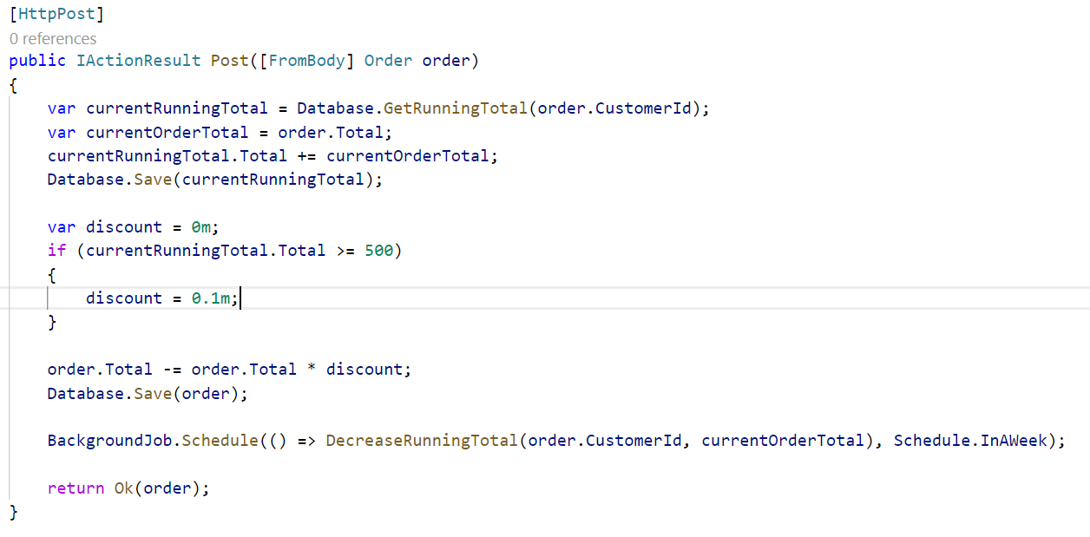

Slide 21
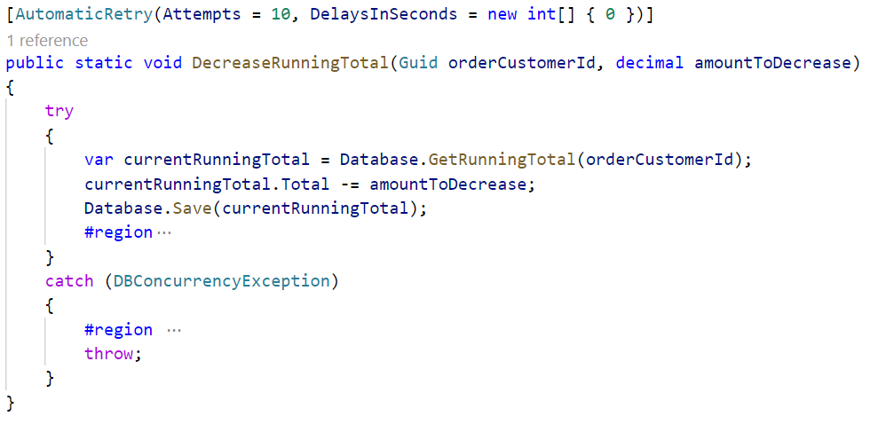

Slide 22
Durable scheduling introduces reliability
Resilient HTTP introduces some reliability
but doesn’t survive restarts
Notes:
As we could see in the demo while this works nicely and also durably saves running total decreases in hangfire the more orders we get the more we end up overloading an infrastructure which is not really built for this type of activity.
Furthermore because we are directly modifying the running total in the transaction of the controller it is possible that we end up with concurrency conflicts caused either from the customer ordering a lot of stuff or the running total being decreased while we are trying to add the current total of an order to the running total. Now we are forced to add retry patterns to the client calls as well as to the scheduler infrastructure. Given that the scheduler infrastructure is durable that’s fine but the HTTP client calls are not really durable. So we effectively end up building a poor mans queuing infrastructure on top of HTTP in memory with retries.
Because with RPC all of the queues are effectively in memory! A lot of stuff waiting to be processed. And messages are stored on disk, and we have more and cheaper disks than memory.
Because of the RPC call chain when ever the latency between the DB and the backend was slow or there was a concurrent update on a row those effects rippled through the callstack to the issuer of the call, which is the front-end.
Furthermore on every request from the front-end a new database transaction was created and when many operations were pending those transactions sometimes rolled back or slowed down the order processing
The temporal and special coupling introduced was horrible. The latency of the storage layer directly influenced the customer facing latency.
SLA couldn’t be fulfilled
Orders got lest when the client of the request stopped retrying
Orders could not be throttled and worst the actual order intent was difficult to find in HTTP callstack exception logs
To make the next step on our programming evolution towards the future we need a different perspective on the problem.
So we need a highly reliable durable transactional way of dealing with time, so that no matter what happens in our system. We won't lose that information.

Slide 23
Orders are ideal to
Fire & forget
from the frontend perspective
Notes:
The domain of order processing is a good domain to apply messaging because every order can be answered with “thank you we will shortly process the order”
So instead of doing a regular HTTP call we can pack the parameters of the HTTP call (headers and bodies) into a message and send it to the backends queue for processing. Let’s call this a SubmitOrder command. With that approach the command becomes the consistency and transaction boundary and queries are decoupled from commands and each individual message can fail and retry without affecting the frontend

Slide 24
Sagas
Notes:
It's not going to look like your average domain model. Let me tell you that. It's not going to have one to many relationships what
this is going to be building on is a pattern that in service we called a saga. But this comes from the saga ideas ultimately taking what
we were talking about here, saying what we have over here is a long running process.
We need a transitionally consistent stateful long running process that can be managed by time the saga pattern was.
Discovered documented in by the database community in the 80’s around the good old mainframes as they were dealing with what's known as Long live transactions.
So they were trying to address the same kind of issues, but more from a data up perspective. What we're now looking at it from a domain driven
design perspective is a behavior down.
So it's not a by the book saga definition, but it follows a lot of those same principles and within services.
We try to make it easier.
To program these types of things because, like, I said number one well time isn't something that we have a very good way of programming, either in net or in Java or in Ruby or in python. It requires a little bit of infrastructure and also requires us to deal with the issue of well, the consistency. What happens if I have a time out being processed at the same time as a new order is coming in.
We need to make sure that those locks hold up and that's why they have to go on the same entity alright. So when dealing with this not going to spend too much time talking about the infrastructure a lot of the ways that sagas behave with regards to an infrastructure perspective
are documented, and you can see it online. I want to talk more about the behavioral modeling side of it.

Slide 25
Frontend
Backend
SQL Database
Back
Front
DiscountPolicy
Storage
ProcessOrder
Order
RabbitMQ
Queue
Notes:
Demo 4
Switch to code

Slide 26
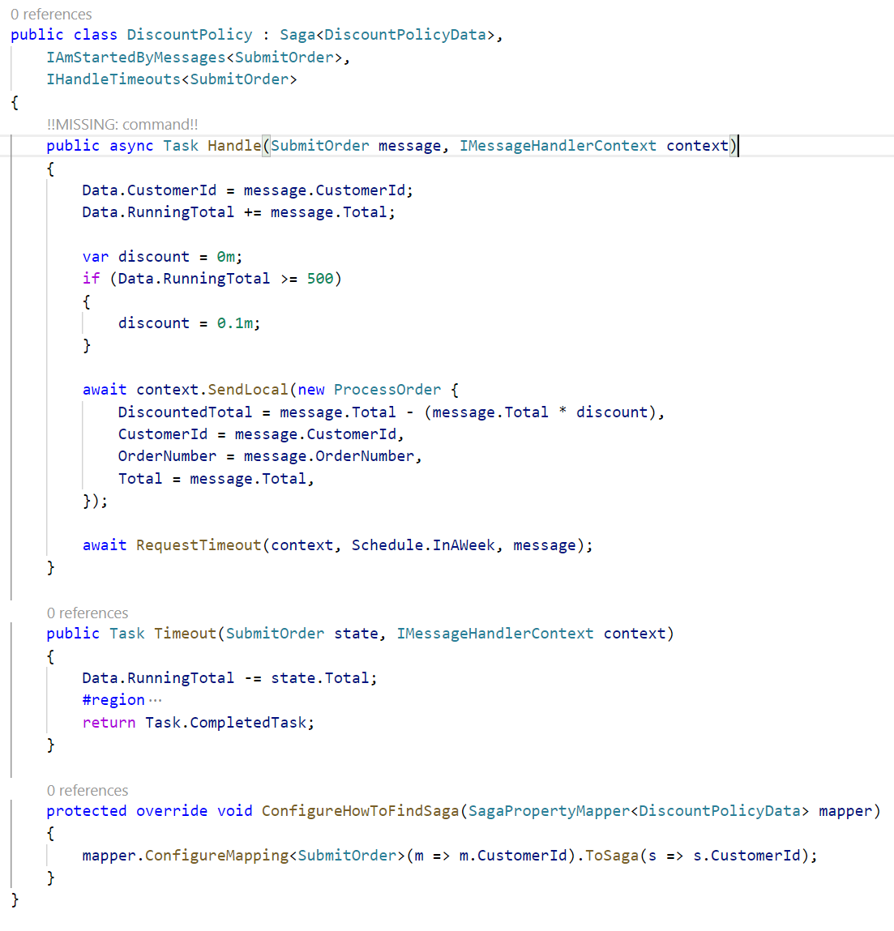

Slide 27
Messaging introduces reliability
Retries resolve concurrency issues automatically
Sagas on top of a robust middleware allow to focus on the business logic and stay reactive

Slide 28
Thanks
Notes:
Thanks

Slide 29
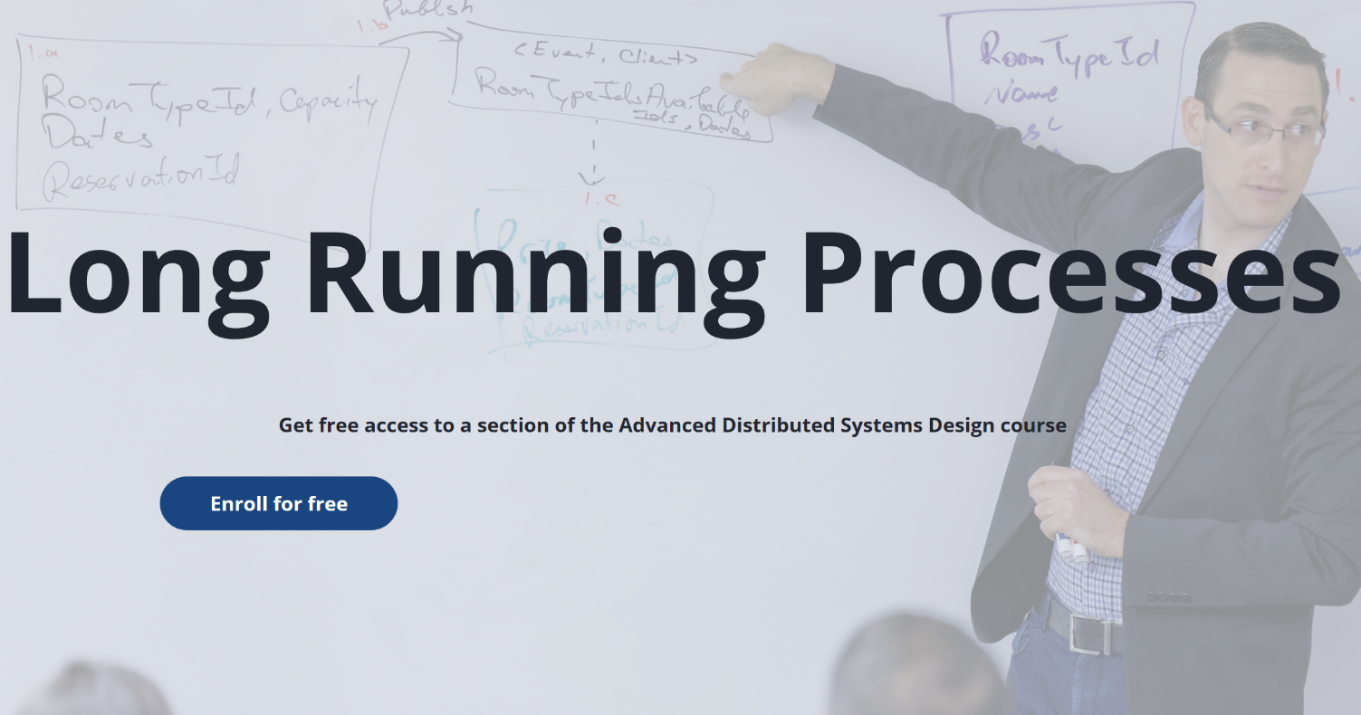

Slide 30
Slides, Links…
github.com/danielmarbach/KnockKnock

Slide 31
Q & A

Slide 32

Software Engineer
Enthusiastic Software Engineer
Microsoft MVP
@danielmarbach
particular.net/blog
planetgeek.ch
Notes:
I’m Daniel, Solution Engineer…
I live in central Switzerland. If you want to know more about me listen to episode 77 of developer on fire
You can reach me on twitter under @danielmarbach
I blog on the particular blog and on my personal blog
I’m the lead behind the asyncification of NServiceBus and the ecosystem around it
I regularly contribute back ideas and code changes to asyncify the .NET OSS libraries and frameworks out there. So far I contributed to Entity Framework, RabbitMQ, Marten, MassTransit, Quartz.NET and many more

Slide 33
Thanks
Notes:
Thank you very much for listening and see you next time

